Slide 1

IN THIS LESSON I WILL…
Learn sports vocabulary
Play a memory game
Watch a video of a story
Draw a picture of my favourite sport

Slide 2


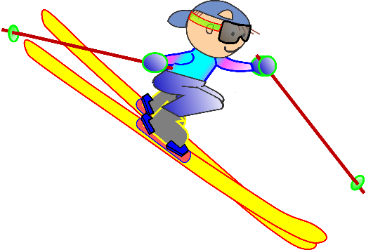
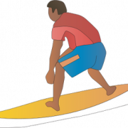



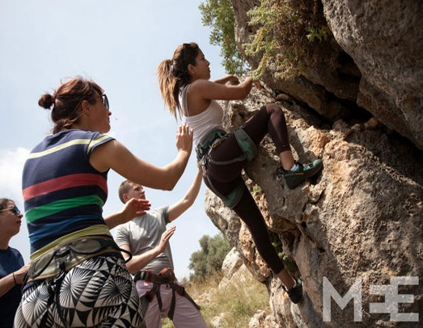
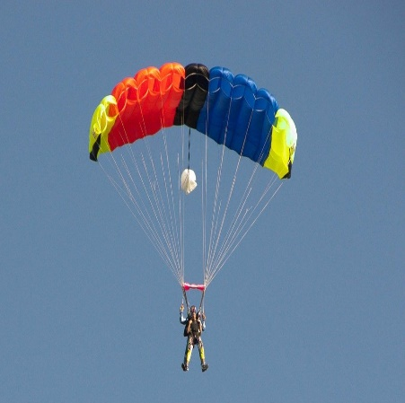
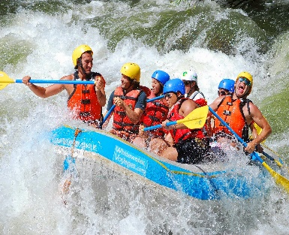
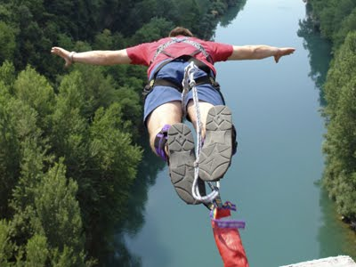
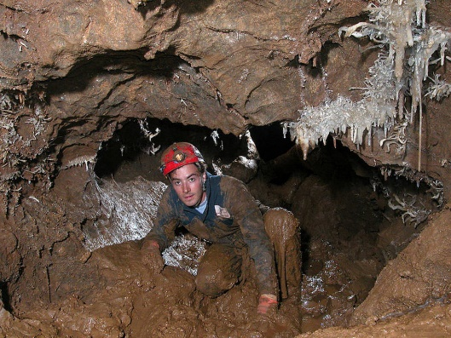
LOOK, READ AND LEARN
basketball
Skiing
surfing
hiking
BMX biking
Rock climbing
Parachuting
Rafting
Caving
Bungeejumping
This Photo by Unknown Author is licensed under CC BY-SA

Slide 3

LET’S PLAY...
Have fun!!!
Click on the link to play this memory game
https://www.eslgamesplus.com/sports-vocabulary-esl-memory-game/

Slide 4


LET’S WATCH A VIDEO…
Now you are going to watch a video about two cousins at an adventure camp. What extreme sports do they do?
Watch the ‘Buzz and Bob's big adventure’ video below and then write down which sports the two cousins do.
https://learnenglishkids.britishcouncil.org/short-stories/buzz-and-bobs-big-adventure

Slide 5

LET’S BE CREATIVE…
        Write and draw!
Which sport would you like to do at an adventure camp? Draw a picture of your favourite sport and write a title or a short paragraph!

Slide 6

Did you enjoy the lesson today?

