Slide 1

IN THIS LESSON I WILL:
Learn the days of the week
Play vocabulary games
Sing a song
Listen to my favourite story “The very hungry caterpillar”
Make a drawing
This Photo by Unknown Author is licensed under CC BY

Slide 2

LET’S START WITH A GAME TO REMEMBER THE ALPHABET!!!
Hi I am a green caterpillar! Τoday we are going to learn English together Do you remember me?
https://www.turtlediary.com/game/letter-recognition.html

Slide 3
Let’s remember the days of the week…..

Slide 4








Look, listen and say

Slide 5
LET’S PLAY
https://wordwall.net/resource/1769390

Slide 6
Let’s sing a song with the days of the week!
https://www.youtube.com/watch?v=3tx0rvuXIRg

Slide 7
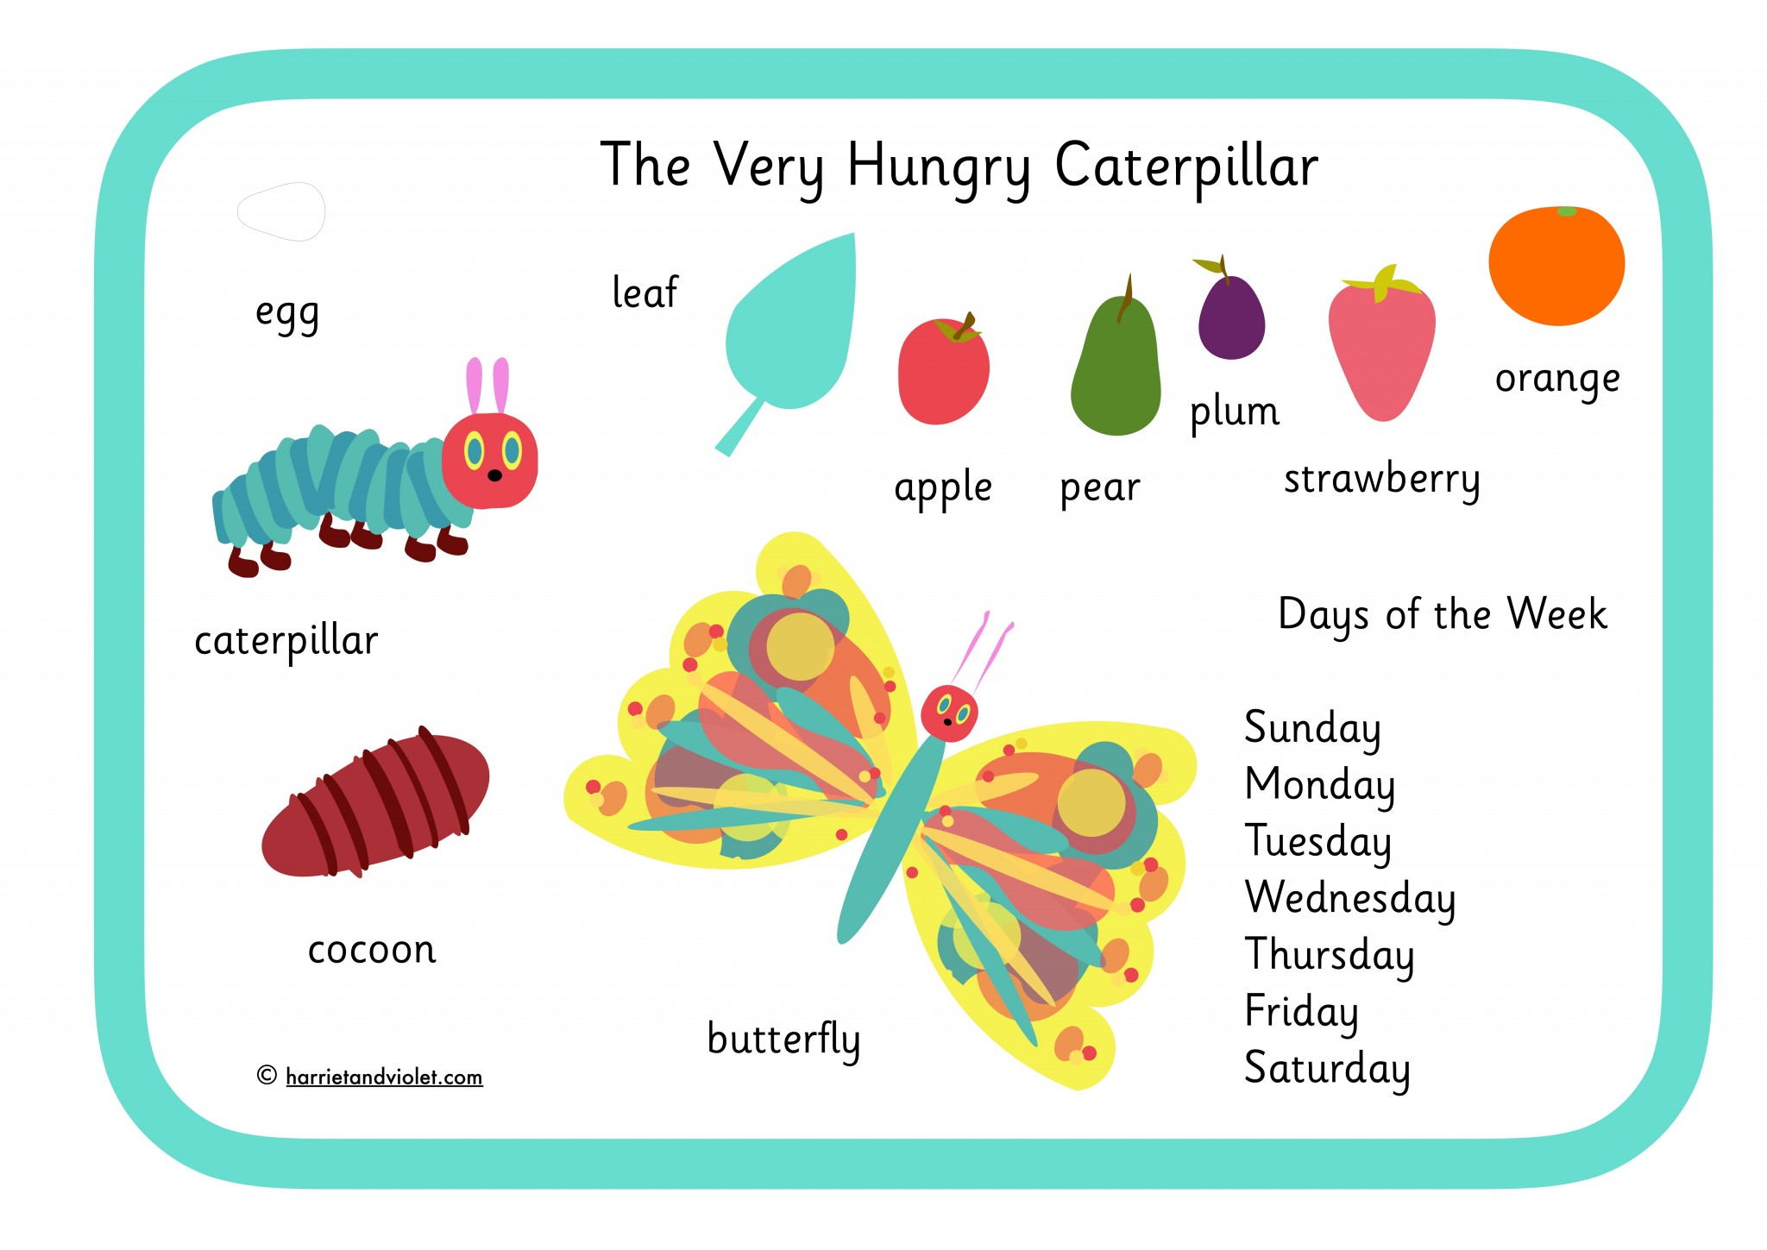
Story time!
LOOK, READ AND REMEMBER

Slide 8

Story time!
Listen to the story by clicking the link below:
https://www.youtube.com/watch?v=75NQK-Sm1YY

Slide 9
Let’s play again….
What did I eat each day of the week? Play the matching game
https://matchthememory.com/hungrycaterpillardaysoftheweek
Match the picture with the correct word!
https://matchthememory.com/hungrycaterpillar

Slide 10








LET’S BE CREATIVE…
        Draw your own caterpillar!
        What does it like to eat every day?

Slide 11

IMAGES COURTESY OF :
https://www.clipart-library.com
https://www.harrieandviolet.com
https://www.memrise.com

