Slide 1
1. Colour the easter egg
https://www.primarygames.com/holidays/easter/games/eastereggscoloring/
2. Play the game
https://www.primarygames.com/holidays/easter/games/egg_hunt/
https://www.learninggamesforkids.com/memory_games/memory_games_match_game.html
3. Do the puzzle
https://www.primarygames.com/holidays/easter/games/dragdrop/
https://www.primarygames.com/holidays/easter/games/eastercrosswordpuzzle/

Slide 2
4. Open your book page 32 “FRIENDS” and listen to the song on Youtube:
https://www.youtube.com/watch?v=5pU8vycGwfY
5. Make an Easter card and write “ HAPPY EASTER”
MEMORY GAMES :
https://www.learninggamesforkids.com/featured-games/color-memory-game.html
https://www.learninggamesforkids.com/memory_games/little-numbers-memory-flip.html

Slide 3
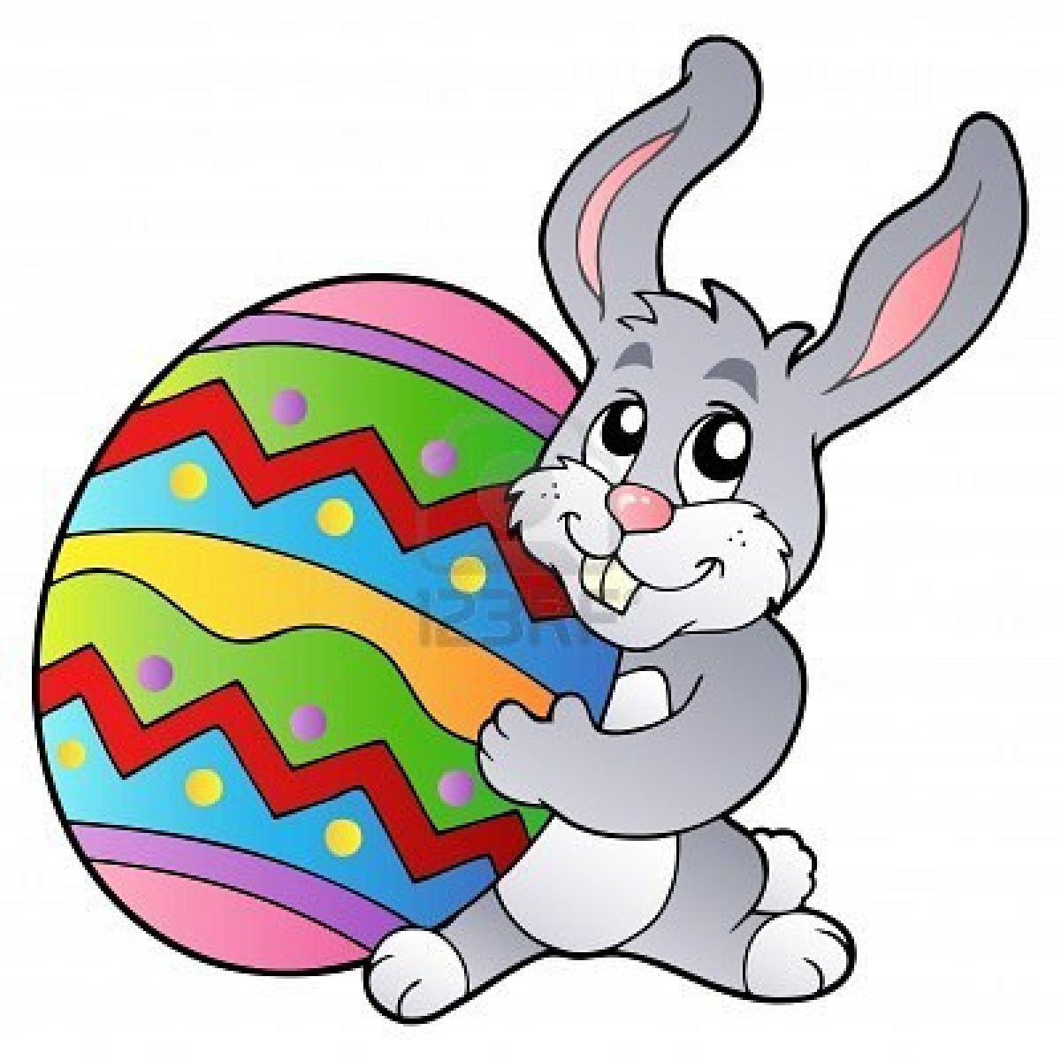
Let’s remember letter “Bb”
Easter bunny
https://www.learninggamesforkids.com/alphabet_games/the-letter-b/letter-b-video.html
https://www.learninggamesforkids.com/alphabet_games/the-letter-b/practice-with-letter-b.html
https://www.learninggamesforkids.com/alphabet_games/the-letter-b/read-b-words.html
This Photo by Unknown Author is licensed under CC BY-NC-ND

