Slide 1
I love toys!

Slide 2
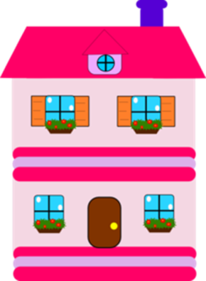
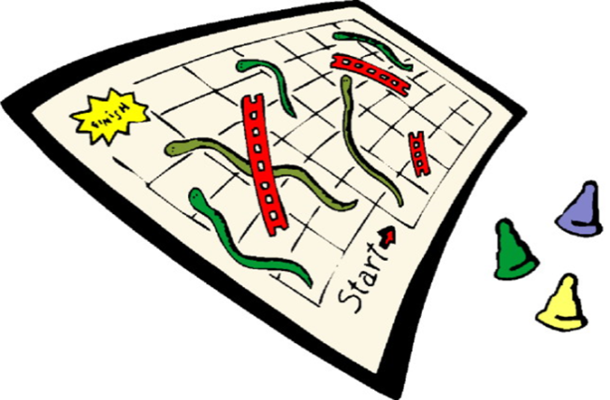
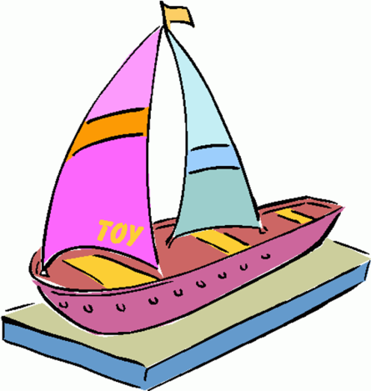
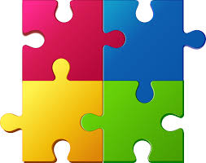
Listen, point and say
doll house
bicycle
board game
train
boat
puzzle

Slide 3
Let’s play!
I spy with my little eye something beginning with …

Slide 4
board game

Slide 5
I spy with my little eye something beginning with …

Slide 6
doll house

Slide 7
I spy with my little eye something beginning with …

Slide 8
puzzle

Slide 9
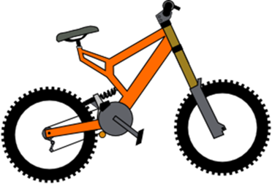
Abracatabra…
It’s a bicycle.

Slide 10
They are bicycles.

Slide 11
Abracatabra…
It’s a train.

Slide 12
They are trains.

Slide 13
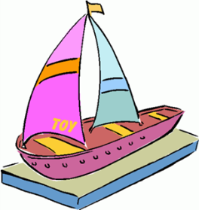
Complete
a train
2 ………………
a doll house
3 …………………
a boat
2 ……………….

Slide 14
Which letter is missing?
tr_in
_uzzle
boa_
_icycle

Slide 15
Let’s sing!
https://www.youtube.com/watch?v=tJKPHvGvEMM

Slide 16
https://matchthememory.com/toysupperlowercase
Let’s play!
https://matchthememory.com/toysyear2

Slide 17
Say the right answer.
It’s a
They are
trains
It’s a
They are
bicycle
It’s a
They are
boats

Slide 18
Good job!

