Slide 1
Ketchup on your cornflakes

Slide 2
Listen, point and say

Slide 3
Say the words happily

Slide 4
Say the words sadly

Slide 5
Say the words loudly

Slide 6
What’s missing?

Slide 14
Let’s play a memory game!
Remember to say the words!
https://matchthememory.com/year1partBunit3

Slide 15
Do you like ketchup?
Yes, I do.

Slide 16
Do you like lemonade?
No, I don’t.

Slide 17
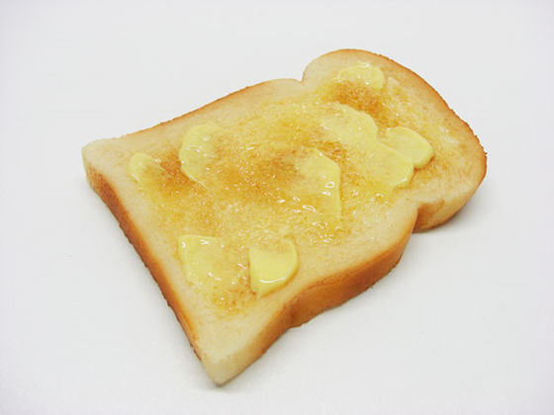
What about you?

Slide 18
Do you like
a teddy
on your
chips?

Slide 19
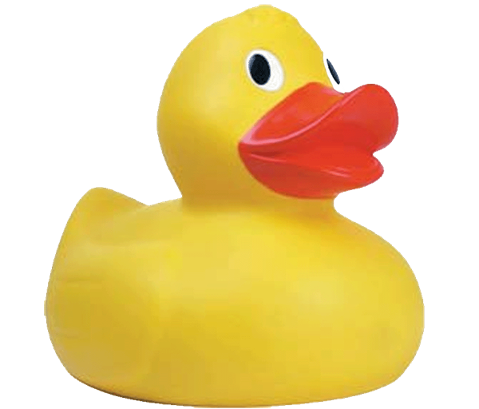
Do you like
a duck
on your
toast?

